Slide 1
LSST DM Overview: For and Beyond LSST Mario Juric LSST Data Management Project Scientist
LSST DM Bootcamp
October. 5th, 2015

Slide 2
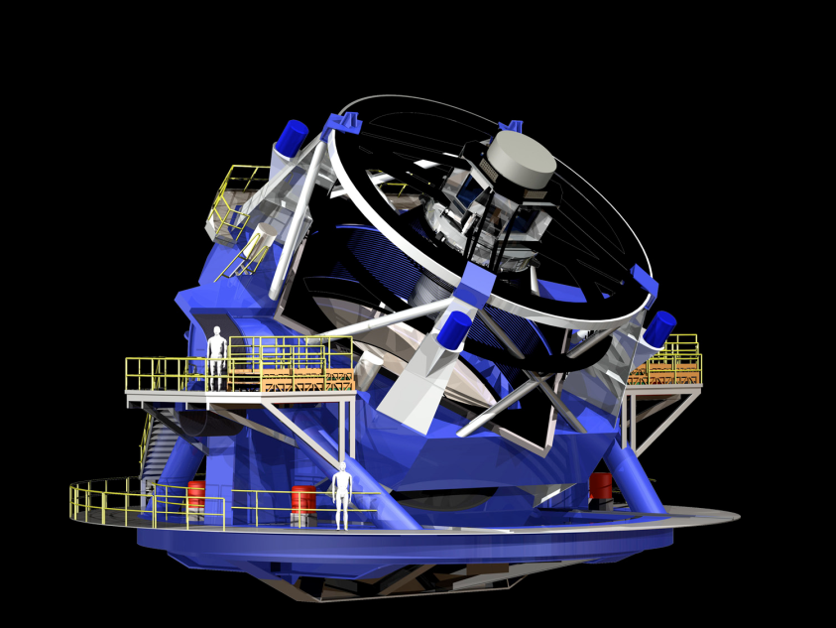
LSST: A Deep, Wide, Fast, Optical Sky Survey
8.4m telescope 18000+ deg² 10mas astrom. r<24.5 (<27.5@10yr)
ugrizy 0.5-1% photometry
3.2Gpix camera 30sec exp/4sec rd 15TB/night 37 B objects
Imaging the visible sky, once every 3 days, for 10 years (825 revisits)

Slide 3
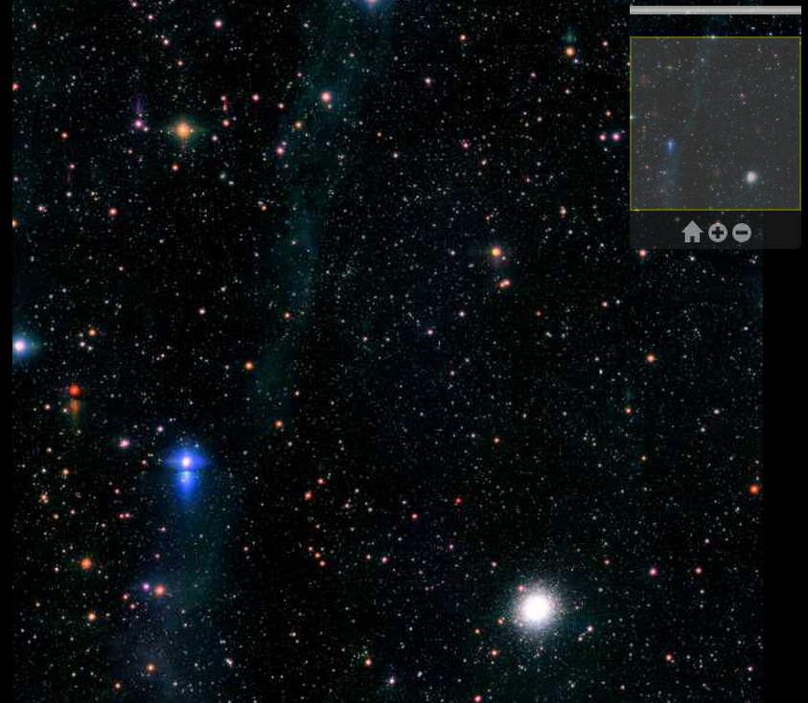
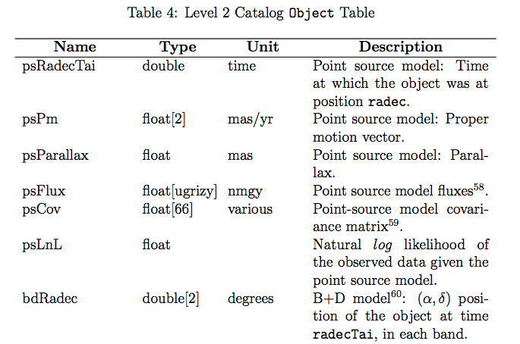
Turning the Sky into a Database
A wide (half the sky), deep (24.5/27.5 mag), fast (image the sky once every 3 days) survey telescope. Beginning in 2022, it will repeatedly image the sky for 10 years.
The LSST will be an automated survey system. In nighttime, the observatory and the data system will operate with minimum human intervention.
The ultimate deliverable of LSST is not the telescope, nor the instruments; it is the fully reduced data.
All science will be come from survey catalogs and images
Telescope ➔ Images ➔ Catalogs

Slide 4
Why LSST: The Science

Slide 5
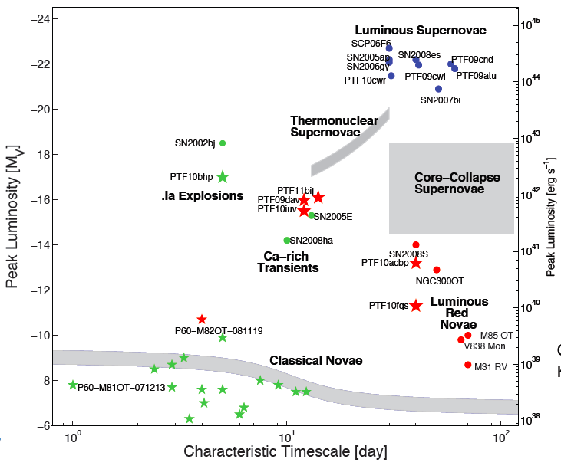
Frontiers of Survey Astronomy (1/4)
Time domain science
Nova, supernova, GRBs
Source characterization
Instantaneous discovery
Census of the Solar System
NEOs, MBAs, Comets
KBOs, Oort Cloud
Mapping the Milky Way
Tidal streams
Galactic structure
Dark energy and dark matter
Strong Lensing
Weak Lensing
Constraining the nature of dark energy
Notes:
NGC5907

Slide 6
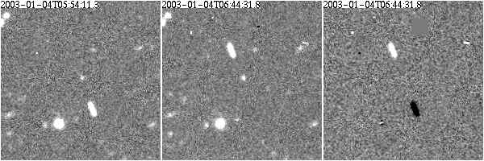
Frontiers of Survey Astronomy (2/4)
Time domain science
Nova, supernova, GRBs
Source characterization
Instantaneous discovery
Census of the Solar System
NEOs, MBAs, Comets
KBOs, Oort Cloud
Mapping the Milky Way
Tidal streams
Galactic structure
Dark energy and dark matter
Strong Lensing
Weak Lensing
Constraining the nature of dark energy
Exposure 1
Exposure 2
Exposure 1
-
Exposure 2
Notes:
NGC5907

Slide 7
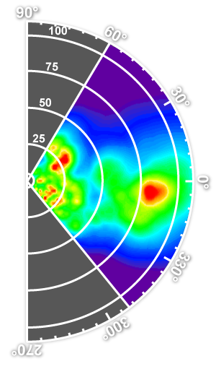
Frontiers of Survey Astronomy (3/4)
Time domain science
Nova, supernova, GRBs
Source characterization
Instantaneous discovery
Census of the Solar System
NEOs, MBAs, Comets
KBOs, Oort Cloud
Mapping the Milky Way
Tidal streams
Galactic structure
Dark energy and dark matter
Strong Lensing
Weak Lensing
Constraining the nature of dark energy
RR Lyrae limit
MS stars limit
Dwarf Galaxies
Notes:
NGC5907

Slide 8
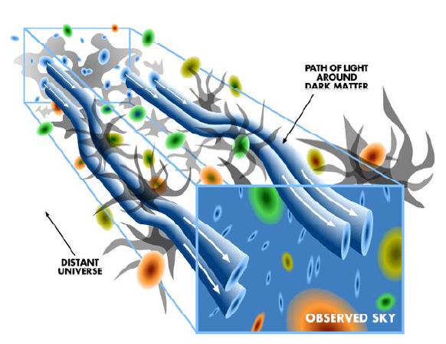
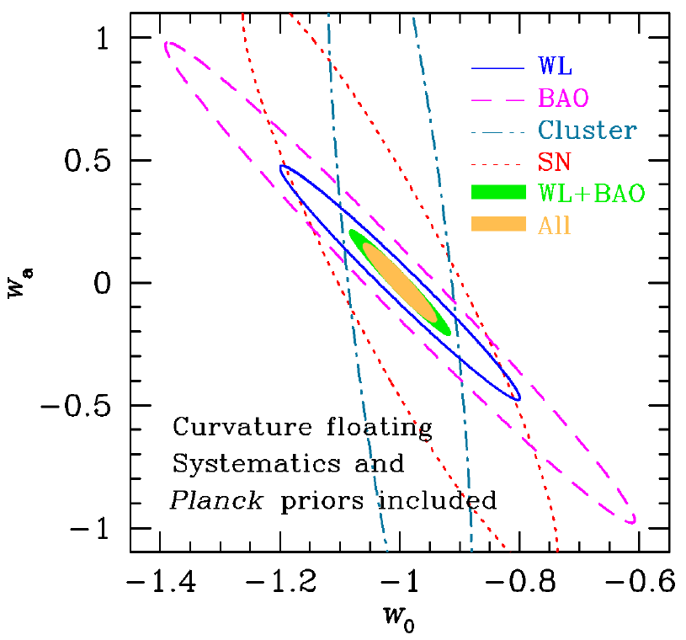
Frontiers of Survey Astronomy (4/4)
Time domain science
Nova, supernova, GRBs
Source characterization
Instantaneous discovery
Census of the Solar System
NEOs, MBAs, Comets
KBOs, Oort Cloud
Mapping the Milky Way
Tidal streams
Galactic structure
Dark energy and dark matter
Strong lensing
Weak lensing
Constraining the nature of dark energy
Notes:
NGC5907

Slide 9
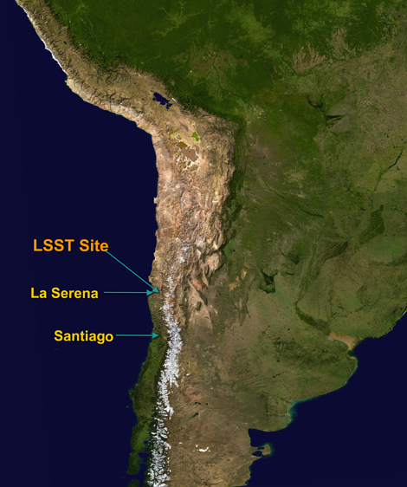
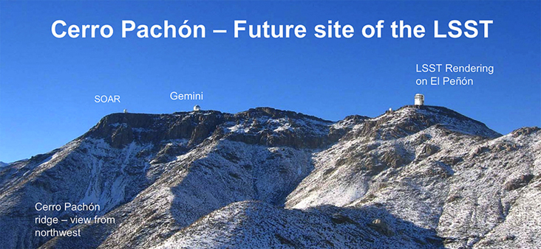
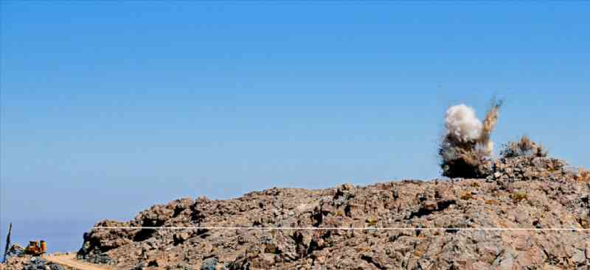
Location: Cerro Pachon, Chile
Leveling of El Peñón (the summit of Cerro Pachón)

Slide 10
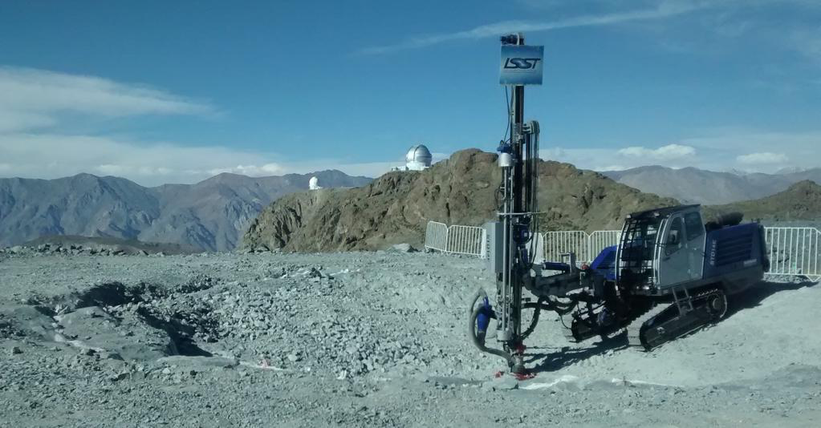
LSST Site (April 14th, 2015)

Slide 11
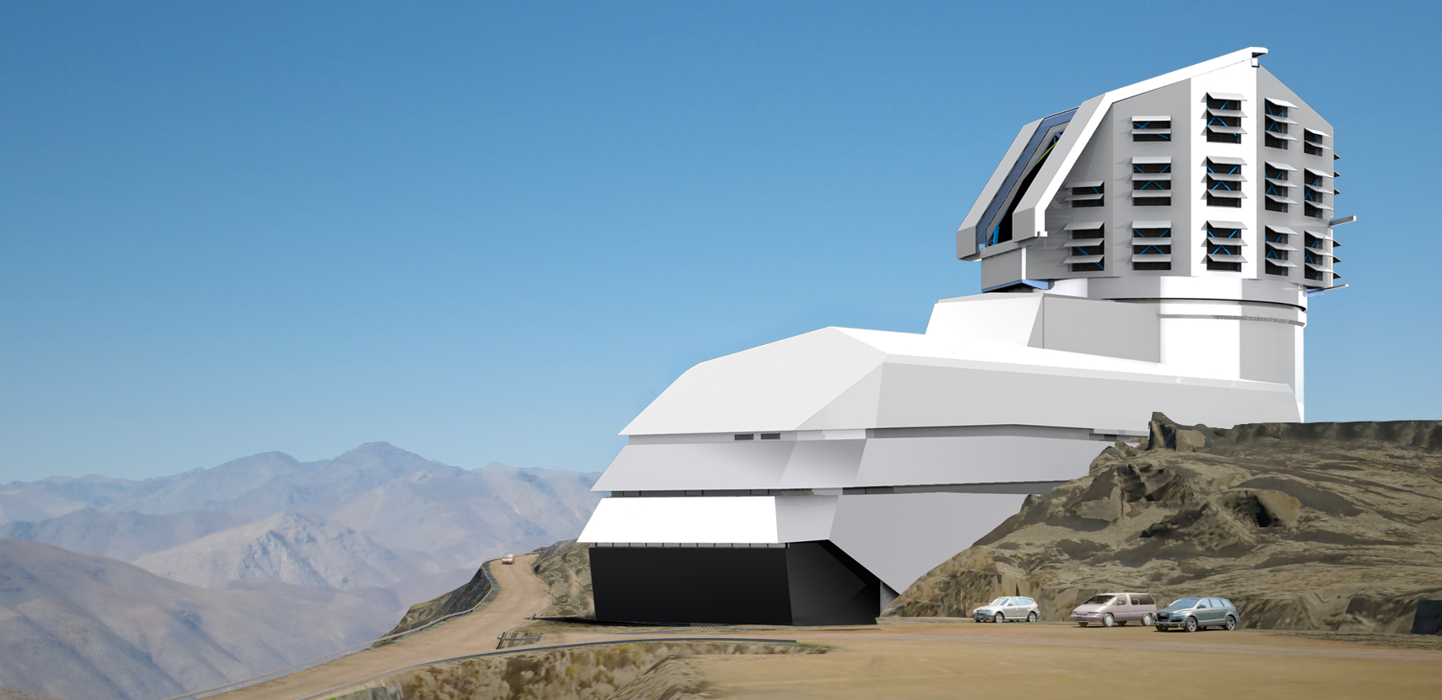
LSST Observatory (cca. late ~2018)

Slide 12
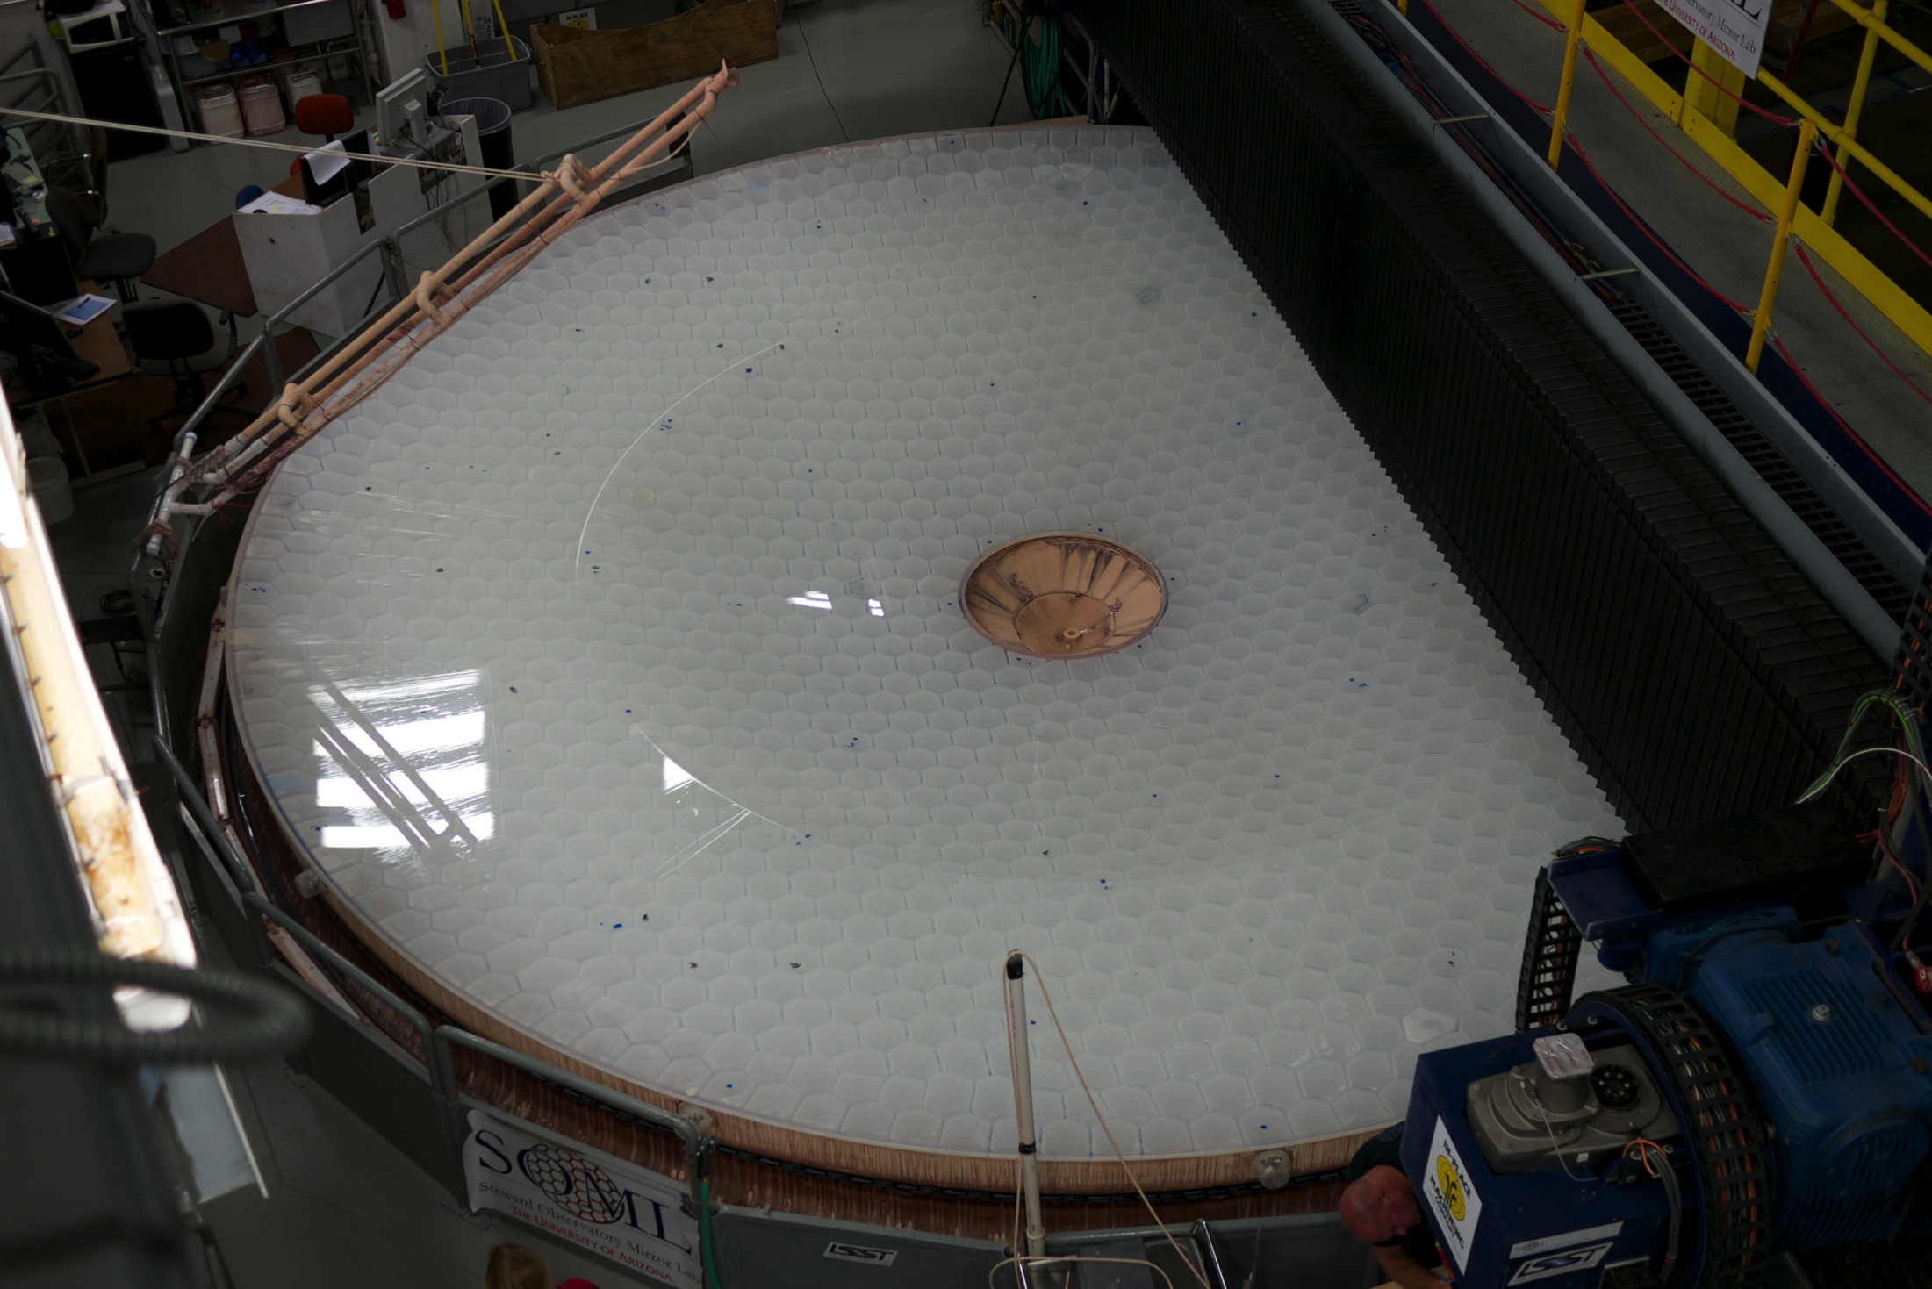
Done!

Slide 13
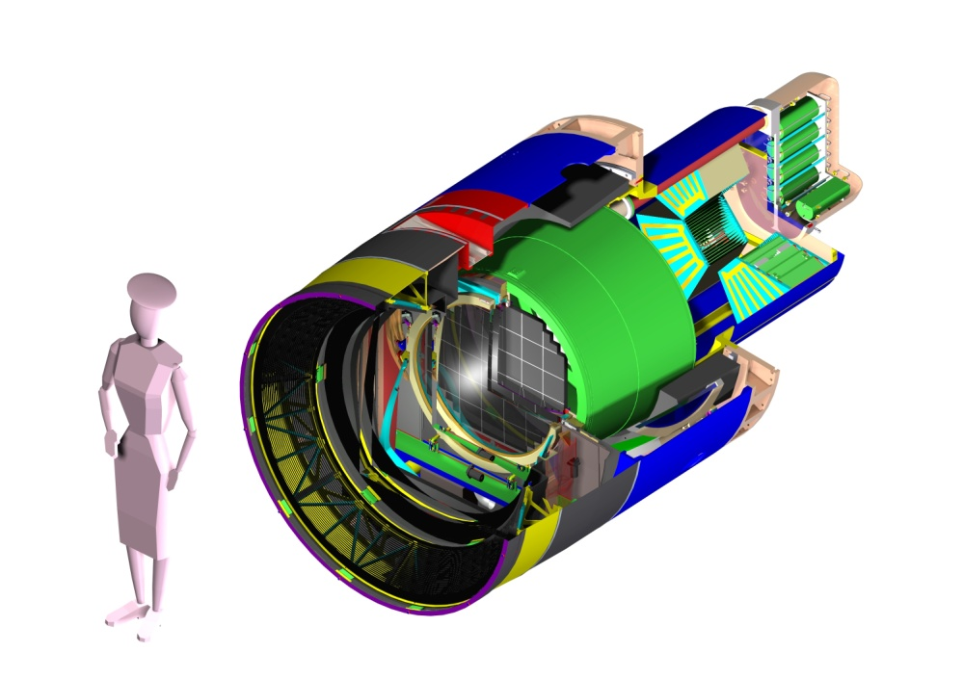
LSST Camera
3.2 Gigapixels
0.2 arcsec pixels
9.6 square degree FOV
2 second readout
6 filters
1.65 m
5’-5”
Parameter | Value
Diameter | 1.65 m
Length | 3.7 m
Weight | 3000 kg
F.P. Diam | 634 mm
Notes:
2.25 Nadne’s of length
Know better than to quote the weight
13

Slide 14
LSST Imaging: ~5 PB/yr
(~5 expensive, information rich PB/yr)
Notes:
~22 Million FY’13 dollars/PB (not including the scientists trying to do the science).
~110 Million FY’13 dollars/yr (not including the scientists trying to do the science).

Slide 15
LSST’s #1 Challenge:
Processing the Data in a way that Enables Science
Notes:
Glasses, Eyes, Brain

Slide 16
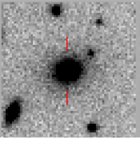
Catalogs: Extracting Information from the Data
Computationally (and cognitively) expensive, science-case speciific
And metadata!
Scientists
Scientists
Model ← inference – Data
Project
Scientists
Scientists
Project
Project
Project
Model ← inference – Catalog ← Data Processing – Data
Computationally expensive, general
Reprojection; may or may not involve compression
Almost always introduces some information loss
Data Processing == Instrumental Calibration + Measurement
Computationally cheaper, Easier to understand, Science-case speciific

Slide 17
Guiding Principles for LSST Products
There are virtually infinite options on what quantities one can measure on images
But if catalog generation is understood as a (generalized) cost reduction tool, the guiding principles become easier to define
Defining principles for the LSST data products:
Maximize science enabled by the catalogs
Working with images takes time and resources; a large fraction of LSST science cases should be enabled by just the catalog.
Minimize information loss
Provide (as much as possible) estimates of likelihood surfaces, not just single point estimators
Provide and document the transformation (the software)

Slide 18
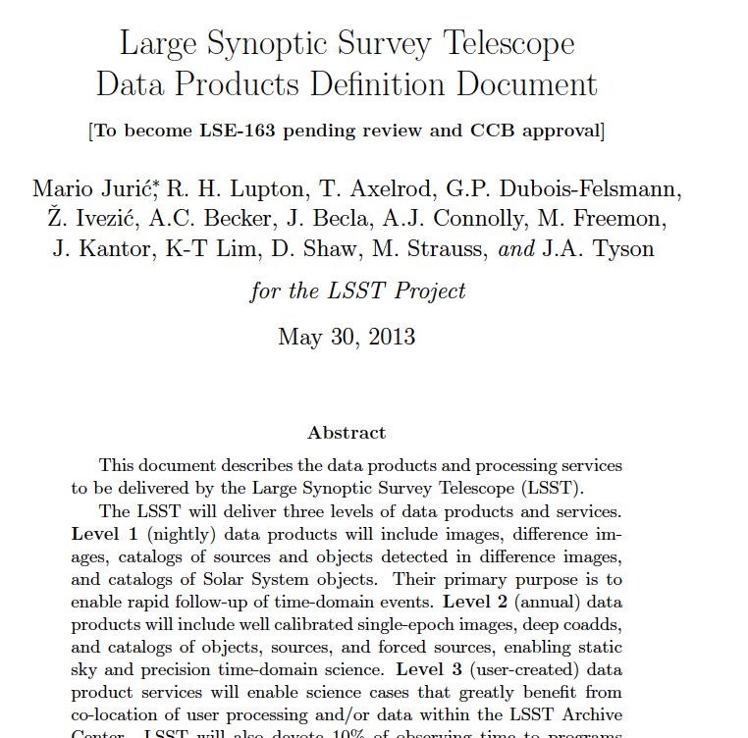
The DPDD Captures the Outcome of this Thinking
LSST Data Products Definition Document
A document giving a high-level description of LSST data products.
http://ls.st/dpdd
Level 1 Data Products: Section 4.
Level 2 Data Products: Section 5.
Level 3 Data Products: Section 6.
Special Programs DPs: Section 7.

Slide 19
LSST From the User’s Perspective: A Data Stream, a Database, and a (small) Cloud
A stream of ~10 million time-domain events per night, detected and transmitted to event distribution networks within 60 seconds of observation.
A catalog of orbits for ~6 million bodies in the Solar System.
A catalog of ~37 billion objects (20B galaxies, 17B stars), ~7 trillion single-epoch detections (“sources”), and ~30 trillion forced sources, produced annually, accessible through online databases.
Deep co-added images.
Services and computing resources at the Data Access Centers to enable user-specified custom processing and analysis.
Software and APIs enabling development of analysis codes.
Level 1
Level 2
Level 3

Slide 20
How do we get this done?

Slide 21








Multiple Groups, One Distributed Team
UI
Database
Mgmt, I&T, and Science QA
Science Pipelines (“Applications”)
Middleware
Infrastructure
Notes:
LSST Cake
Stairway to Heaven

Slide 22
Top-level Coordination
DM Project Engineer
Planning and Execution (@ktl)
DM Project Manager
Resources and Compliance (Jeff Kantor)
DM Project Scientist
Vision, Strategy and Goals (@mjuric)
More tomorrow.

Slide 23
LSST DM System Vision
We will enable LSST science by creating a well documented, state-of-the-art, high-performance, scalable, multi-camera, open source, O/IR survey data processing and analysis system.
We will extensivelly test this system on pre-cursor data and surveys.
We will make it easy for anyone to deploy and run the software we write.

Slide 24

LSST Operations: Sites and Data Flows
French Processing Center (CC-IN2P3, Lyon, France)
Data Release Production (50%)
French DAC
Archive Site
Archive Center
Alert Production
Data Release Production (50%)
EPO Infrastructure
Long-term Storage (copy 2)
Data Access Center
Data Access and User Services
Summit and Base Sites
Telescope and Camera
Data Acquisition
Crosstalk Correction Long-term storage (copy 1)
Chilean Data Access Center
HQ Site
Science Operations Observatory Management Education and Public Outreach

Slide 25
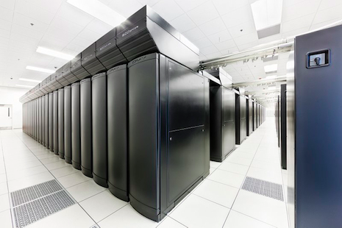
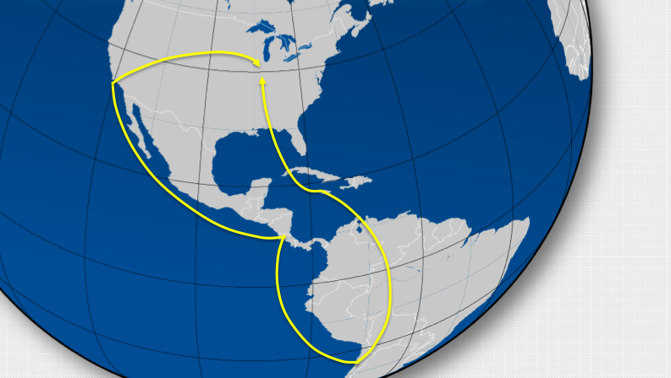
Infrastructure: Petascale Computing, Gbit Networks
The computing cluster at the LSST Archive (at NCSA) will run the processing pipelines.
Single-user, single-application, dedicated data center
Process images in real-time to detect changes in the sky
Produce annual data releases
Archive Site and U.S. Data Access Center
NCSA, Champaign, IL
Long Haul Networks to transport data from Chile to the U.S.
200 Gbps from Summit to La Serena (new fiber)
2x40 Gbit (minimum) for La Serena to Champaign, IL (protected, existing fiber)
Base Site and Chilean Data Access Center
La Serena, Chile

Slide 26
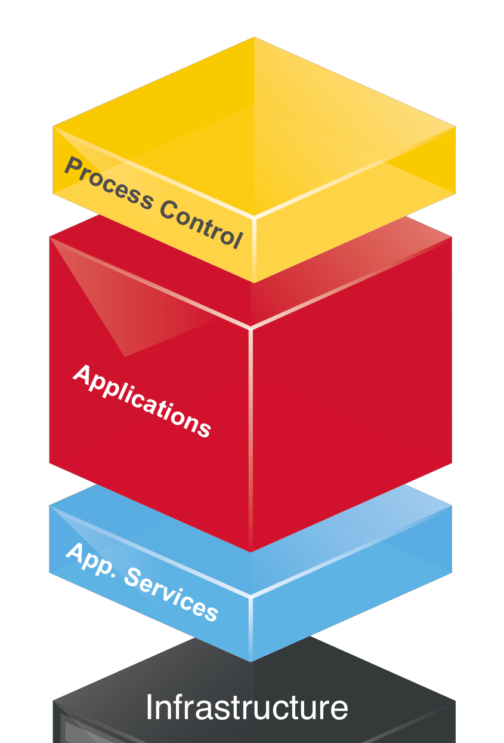

“Applications”: Scientific Core of LSST DM
Applications (aka Science Pipelines) carry the core scientific algorithms that process or analyze raw LSST data to generate output Data Products
Variety of processing
Image processing
Measurement of source properties
Associating sources across space and time, e.g. for tracking solar system objects
Applications framework layer (afw; not shown) allows them to be written in a high-level language

Slide 27
LSST Science Pipelines
02C.01.02.01/02. Data Quality Assessment Pipelines
02C.01.[02.01.04,04.01,04.02] Calibration Pipelines
02C.03.01. Single-Frame Processing Pipeline
02C.03.02. Association pipeline
02C.03.03. Alert Generation Pipeline
02C.03.04. Image Differencing Pipeline
02C.03.06. Moving Object Pipeline
02C.04.03. PSF Estimation Pipeline
02C.04.04. Image Coaddition Pipeline
02C.04.05. Deep Detection Pipeline
02C.04.06. Object Characterization Pipeline
02C.01.02.03. Level 3 Toolkit
02C.03.05/04.07 Core Libraries (afw)
Level 1
Level 2
L3
+ middleware, databases, user interfaces, computing+storage hardware, networking, etc…
Data Management Applications Design (LDM-151)

Slide 28
Maintainable Design / Language Choices
LSST software stack is largely being written from scratch, in Python 2.7 (w. Python 3 compatible syntax), unless computational demands require the use of C++
C++:
Computationally intensive code
Made available to Python via SWIG
Python:
All high-level code
Prefer Python to C++ unless performance demands otherwise
Modularity
Virtually everything is a Python module.
100+ packages (git repositories, ~corresponding to python packages)
Build system: scons Version control: git Package management: EUPS

Slide 29
Implementation Strategy: Transfer Know-how, not Code
Difficulty adapting existing public codes to LSST requirements (AstroMatic suite, PHOTO, Elixir, IRAF-based pipelines, etc.)
Need to run efficiently at scale
Need to be flexible (plugging/unplugging of algorithms at runtime)
Need to have it developed by a large team (20+ scientists and programmers)
Need to be maintainable over ~25 years of R&D, Construction, and Survey Operations
Need to run on a variety of hardware and software platforms
Need to have logging and provenance built into the design
Early on (~2006), a decision was made to (largely) transfer the scientific know-how, but not code.

Slide 30
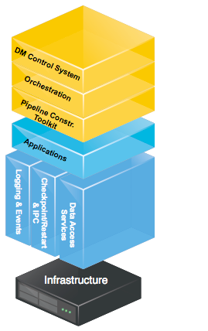
Middleware Layer: Isolating Hardware, Orchestrating Software
Enabling execution of science pipelines on hundreds of thousands of cores.
Frameworks to construct pipelines out of basic algorithmic components
Orchestration of execution on thousands of cores
Control and monitoring of the whole DM System
Isolating the science pipelines from details of underlying hardware
Services used by applications to access/produce data and communicate
"Common denominator" interfaces handle changing underlying technologies

Slide 31
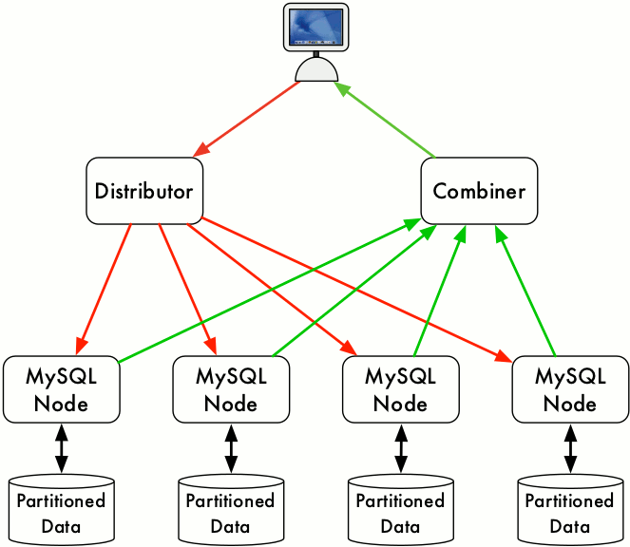
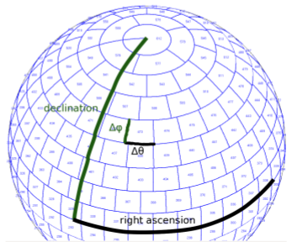
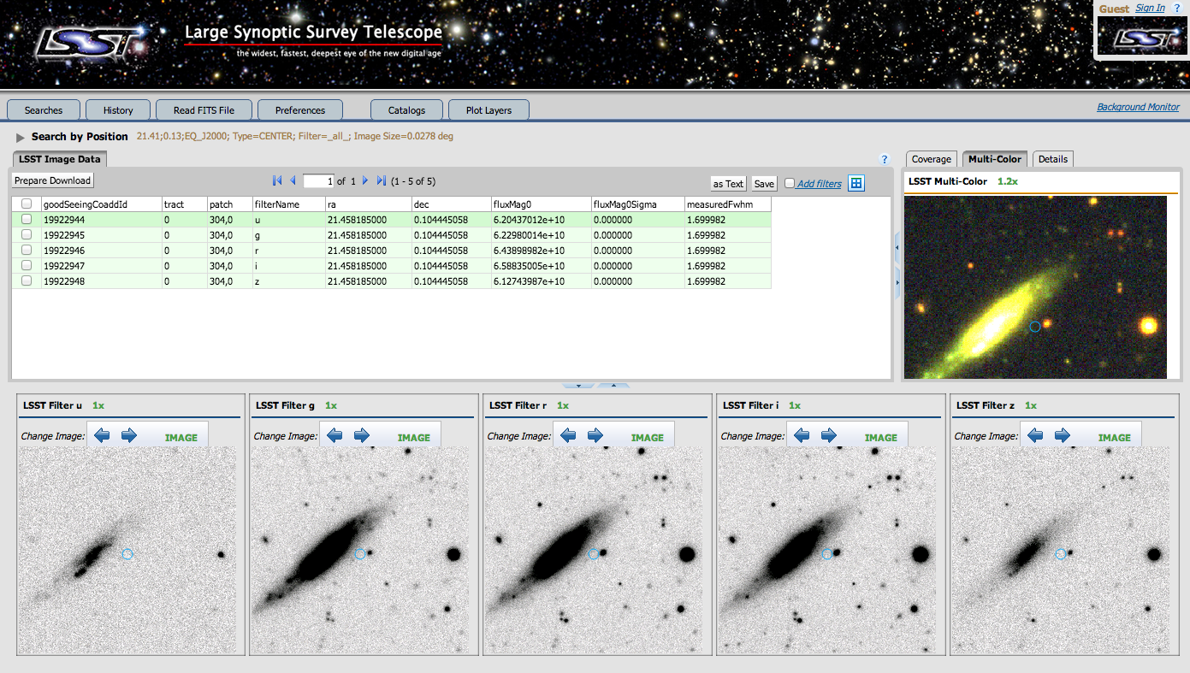
Database and Science UI: Delivering to Users
Massively parallel, distributed, fault-tolerant relational database.
To be built on existing, robust, well-understood, technologies (MySQL and xrootd)
Commodity hardware, open source
Advanced prototype in existence (qserv)
Science User Interface to enable the access to and analysis of LSST data
Web and machine interfaces to LSST databases
Visualization and analysis capabilities

Slide 32
LSST From the User’s Perspective: A Data Stream, a Database, and a (small) Cloud
A stream of ~10 million time-domain events per night, detected and transmitted to event distribution networks within 60 seconds of observation.
A catalog of orbits for ~6 million bodies in the Solar System.
A catalog of ~37 billion objects (20B galaxies, 17B stars), ~7 trillion single-epoch detections (“sources”), and ~30 trillion forced sources, produced annually, accessible through online databases.
Deep co-added images.
Services and computing resources at the Data Access Centers to enable user-specified custom processing and analysis.
Software and APIs enabling development of analysis codes.
Level 1
Level 2
Level 3

Slide 33
Level 1: Transients Alerts
LSST computing is sized for 10M alerts/night (average), 10k/visit (average), 40k/visit (peak)
Dedicated networking for moving data from Chile to the US
New image differencing pipelines with improved algorithms
Will measure and transmit with each alert:
position
flux, size, and shape
light curves in all bands (up to a ~year; stretch: all)
variability characterization (eg., low-order light-curve moments, probability the object is variable)
cut-outs centered on the object (template, difference image)

Slide 34
Level 1 Processing: Sequence Diagram Concept

Slide 35
Level 1 Processing: System Architecture

Slide 36
Level 2: Annual Data Releases
Well calibrated, consistently processed, catalogs and images
Catalogs of objects, detections, detections in difference images, etc.
Made available in Data Releases
Annually, except for Year 1
Two DRs for the first year of data
Complete reprocessing of all data, for each release
Every DR will reprocess all data taken up to the beginning of that DR
Projected catalog sizes:
18 billion objects (DR1) ➔ 37 billion (DR11)
750 billion observations (DR1) ➔ 30 trillion (DR11)

Slide 37
Data Release Processing: Logical Flow
DRP begins with processing, detection, and measurement on single frames, generating Sources.
These are used to photometrically and astrometrically calibrate the survey.
A series of coadds is built next, where Objects are detected.
Detections on co-adds are deblended and associated to form a master object list.
The objects are simultaneously characterized in all observed epochs (MultiFit).
Time variability is characterized by independent measurement of Forced Sources in individual epochs.

Slide 38
Level 3
(and why it may be more important than we think)

Slide 39
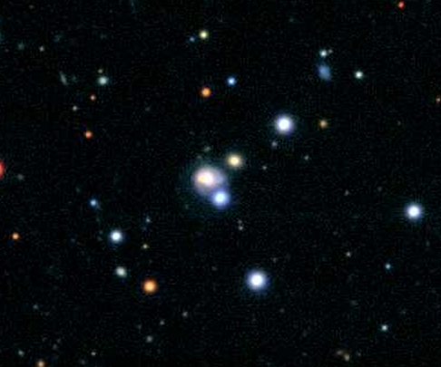
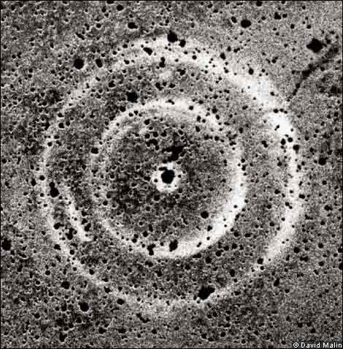
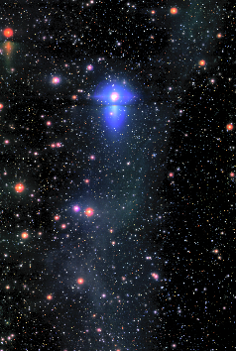
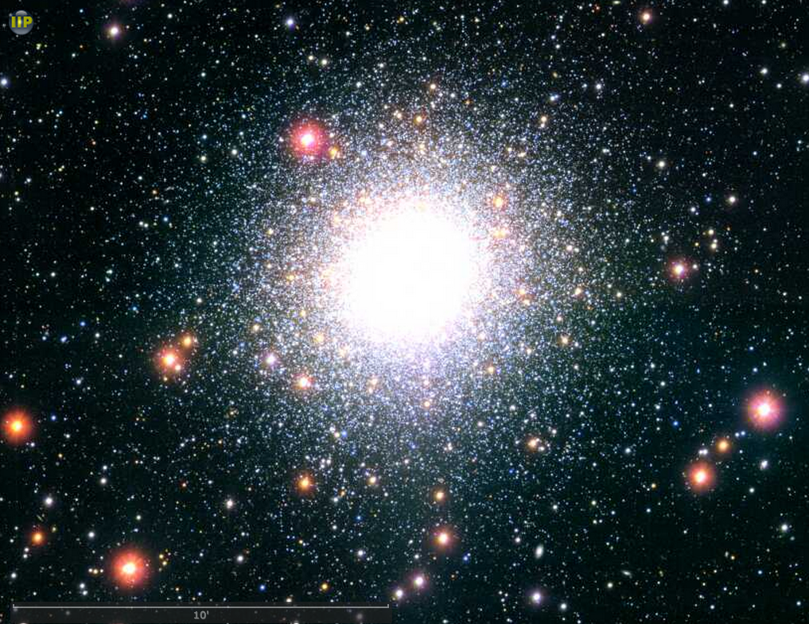
LSST’s Long-Term Legacy: Software
Model ← inference – Data
Model ← inference – Catalog ← Data Processing – Data
As our measurements become more and more systematics limited, what occurs in the “Data Processing” box above becomes incredibly important.
Sometimes, an assumption or an algorithmic choice that’s been made there may introduce a systematic that drowns out the signal (or eliminates it).
Different deblending algorithm (or no deblending)
Extremely crowded field photometry (e.g., globular clusters)
Searching for SNe light echos
Characterization of diffuse structures (e.g., interstellar matter, streams)
For optimal inference, one would always construct a measurement that directly forward-models the aspect of the imaging data they’re interested in, and not the catalog. Or derive a more appropriate catalog. Can we do this?

Slide 40
LSST’s Long-Term Legacy: Software
LSST “Level 3” concept is the first step in that direction: Enabling the community to create new products using LSST’s software, services, or computing resources. This means:
Providing the software primitives to construct custom measurement/inference codes
Enabling the users to run those codes at the LSST data center, leveraging the investment in I/O (piggyback onto LSST’s data trains).
Looking ahead: Right now, we see the data releases as the key product of a survey. By the end of LSST, I wouldn’t be surprised if we saw the software as the key product, with hundreds specialized (and likely ephemeral) catalogs being generated by it.
The “data releases” will just be some of those catalogs, designed to be more broadly useful than others, and retained for a longer period of time.
We want to engineer our software and hardware to make this possible.

Slide 41
The Takeaway Points

Slide 42
Keep in mind what we’re doing and why
LSST DM System Vision
We will enable LSST science by creating a well documented, state-of-the-art, high-performance, scalable, multi-camera, open source, O/IR survey data processing and analysis system.
We will extensively test this system on pre-cursor data and surveys.
We will make it easy for anyone to deploy and run the software we write.

Slide 43
Question, learn, own the problem
This workshop is indented to get you up to speed with the existing code, conventions, and DM plans. Ask questions at any time!
But you will also learn about the DM team culture. Here’s how I’d describe the elements I see as key:
Understand: Think! Understand your work, and why you’re doing it. Don’t just turn knobs and hope for the best; understand why something works (or doesn’t). Pushing the cutting edge is only possible through understanding of our problems. Always understand the context of your work. We’re building pieces of one big puzzle; that’s the only way to make sure they’ll fit.
Question and be Curious: Always strive to learn more about why things are done and built the way they are. Don’t settle; propose and argue for improvements. Don’t fear giving feedback. But also, expect to be questioned about your decisions. Understand our BDFL-ish model, and commit to decisions that are taken.
Work with the Team, Deliver, and Earn Trust: The ability to work with the team, to solve problems, and (ultimately) to deliver, is the currency of this team. That is how we earn trust from each other, and how we make progress.

Slide 44
Understand what we’re trying to build
Read the LSST Overview Paper
http://arxiv.org/pdf/0805.2366.pdf
Read the Data Products Definition Document
http://ls.st/lse-163
Read the System Design Documents
Overall System Design: http://ls.st/ldm-148
Science Pipelines: http://ls.st/ldm-151
Middleware: http://ls.st/ldm-152
Database: http://ls.st/ldm-153

